Slide 1
Image Editing
SDEdit
ILVR
(+RCDM)

Slide 2
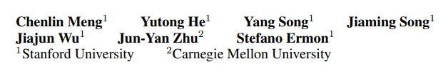
SDEdit: Guided Image Synthesis and Editing with Stochastic Differential Equstions
arXiv, 2021, 462 citation

Slide 3
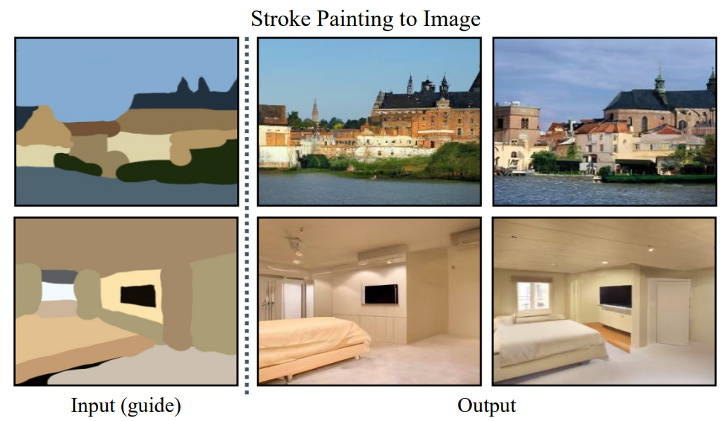
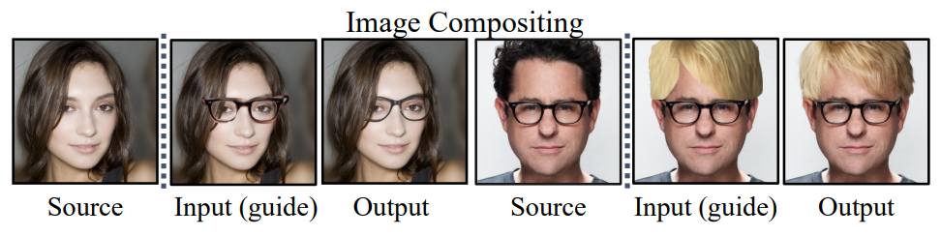
Intro
Problem
Hand-drawn colored strokes
Synthesis image

Slide 4
Related Work
GAN-based
Conditional GAN
GAN inversion
Require additional dataset/loss function
In this paper, there are no additional dataset/loss function

Slide 5
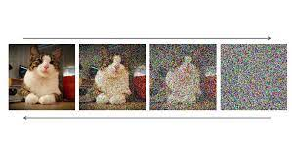
Background
Diffusion models
Forward process: add noise | Reverse process: remove noise
If diffusion models was trained by cat images, models generate cat images
In other words, diffusion models have the ability to generate from a trained distribution (e.g., cat)
Forward process (add noise)
Reverse process (remove noise)

Slide 6
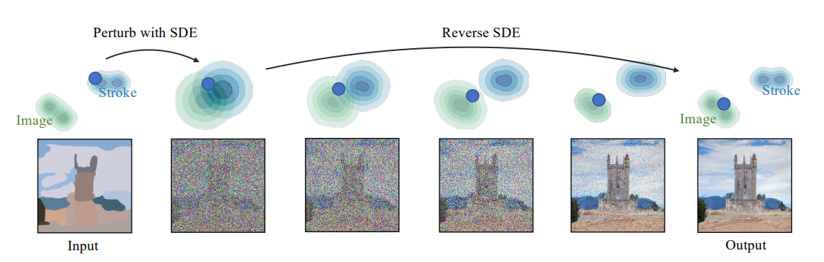
Method
Using noise perturbation
Blend stroke painting distribution and natural image distribution
If there is enough noise in stroke painting, diffusion models doesn’t know where this image comes from
Pre-trained diffusion models have the capability of generating natural images

Slide 7
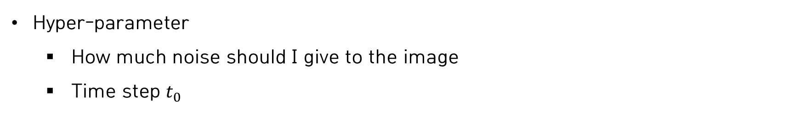


Method
Hyper-parameter
How much noise should I give to the image
Time step $t_{0}$
Forward process (add noise)
Reverse process (remove noise)
$$t_{0}=0$$
$$t_{0}=1$$

Slide 8
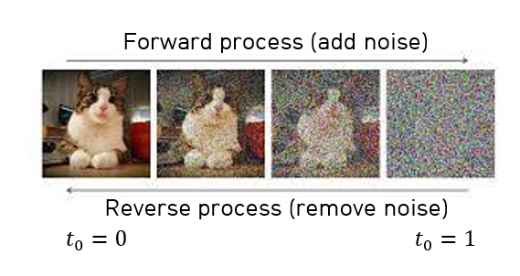
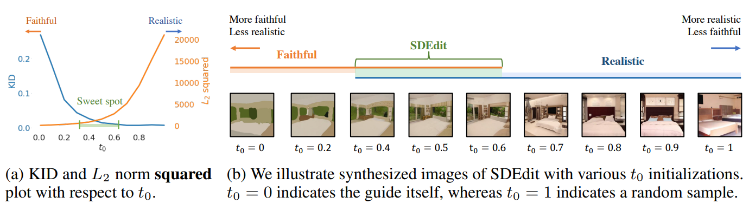
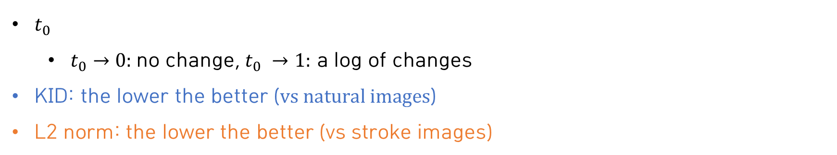
Method
$t_{0}$
$t_{0}→0:$no change, $t_{0} →1:$ a log of changes
KID: the lower the better ($vs natural images$)
L2 norm: the lower the better (vs stroke images)

Slide 9
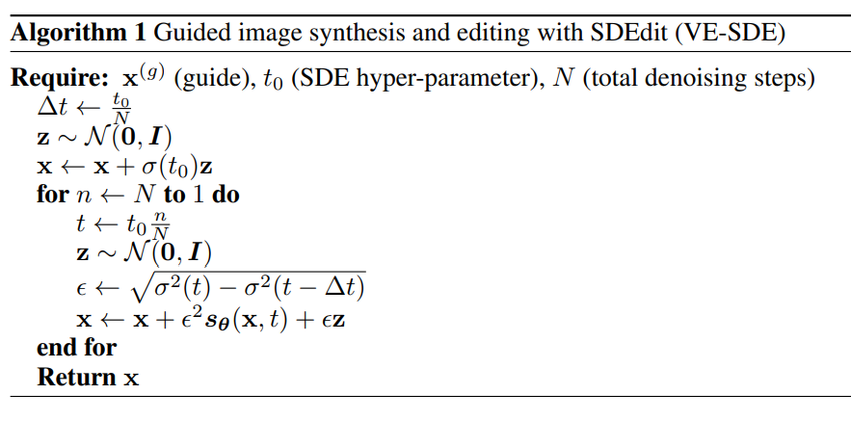
Method
Algorithm

Slide 10
Method
Algorithm
Noise injection for blending

Slide 11
Method
Algorithm
Noise injection for blending
Denoising (reverse process)

Slide 12
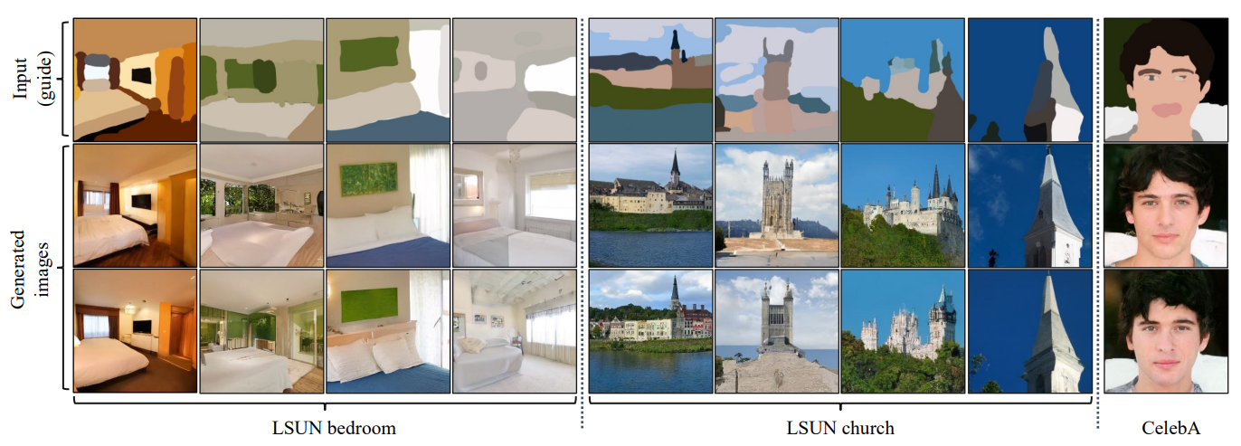
Experiments
Stroke painting

Slide 13
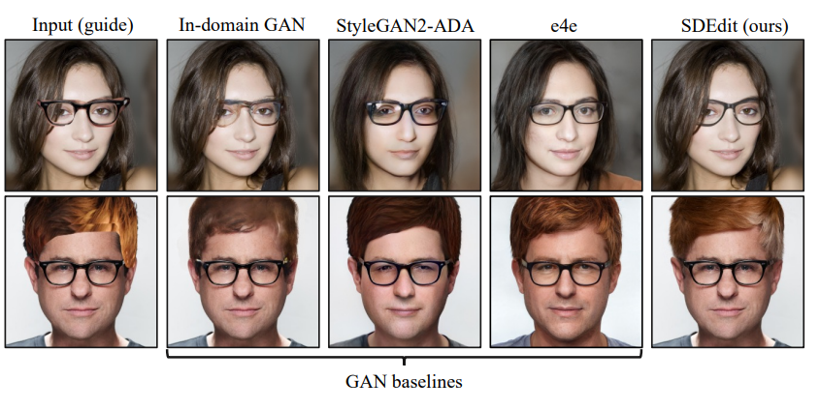
Experiments
Synthesis image
Noise injection for blending
Denoising (reverse process)

Slide 14
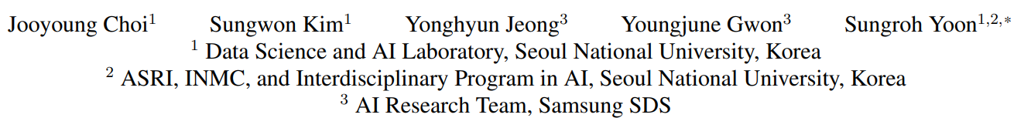
ILVR: Conditioning Method for Denoising Diffusion Probabilistic Models
arXiv, 2021, 317 citation

Slide 15
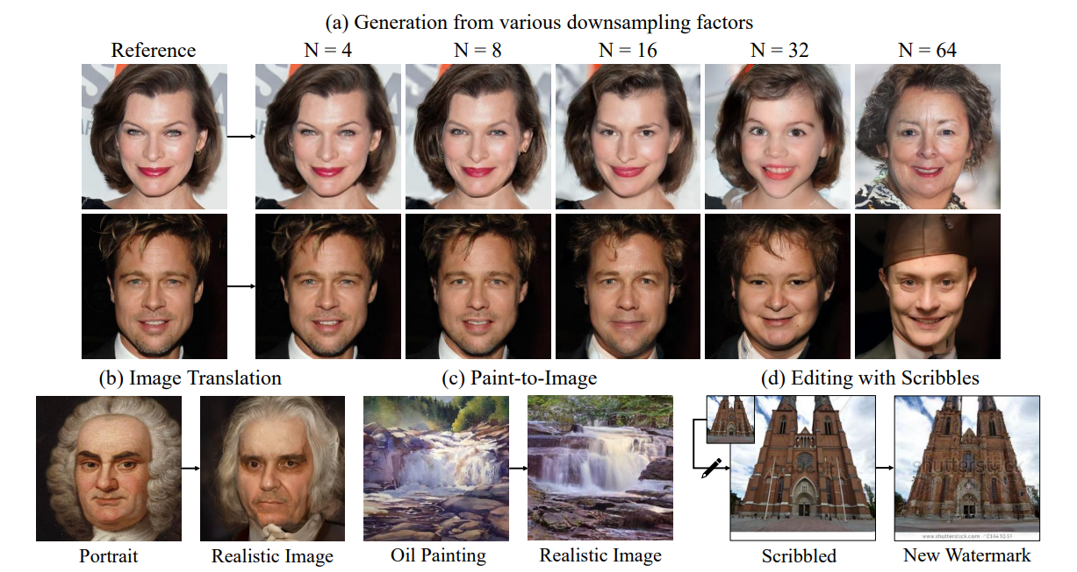
Intro
Objective
Generate image variation

Slide 16
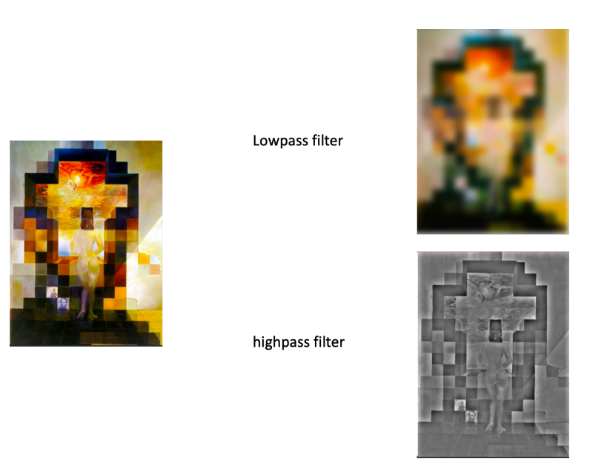
Background
Low frequency in image
We can make low frequency in image via low-pass filter

Slide 17
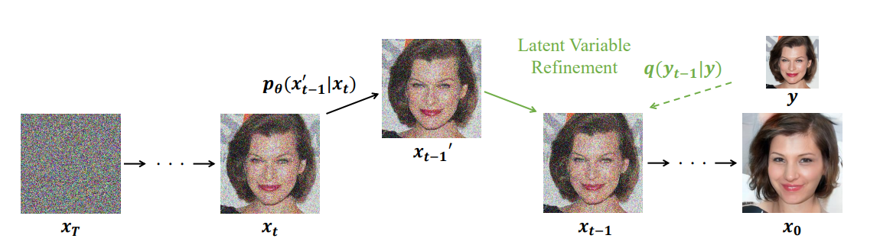
Method
Reference image
We want to generate variation of reference image
Based on low frequency information of reference image, model generates
When the model denoise, change low frequency info
Reference image

Slide 18
Method
Reference image
We want to generate variation of reference image
Based on low frequency information of reference image, model generates
When the model denoise, change low frequency info
Reference image
Denoising
Low-pass filter

Slide 19
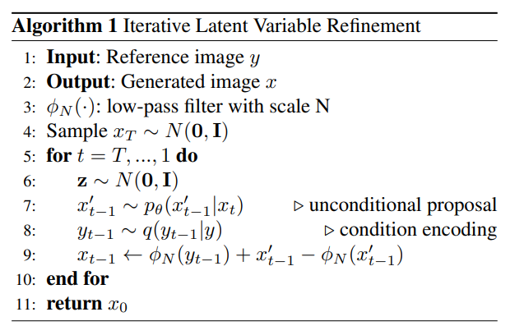
Method
Algorithm

Slide 20
Method
Algorithm
Denoising

Slide 21
Method
Algorithm
Denoising
Add noise to reference image

Slide 22
Method
Algorithm
Denoising
Add noise to reference image
Replace low frequency in image being created

Slide 23
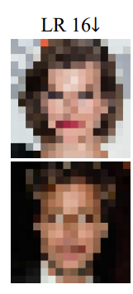
Method
Algorithm
Based on low frequency information of reference image, model generates

Slide 24
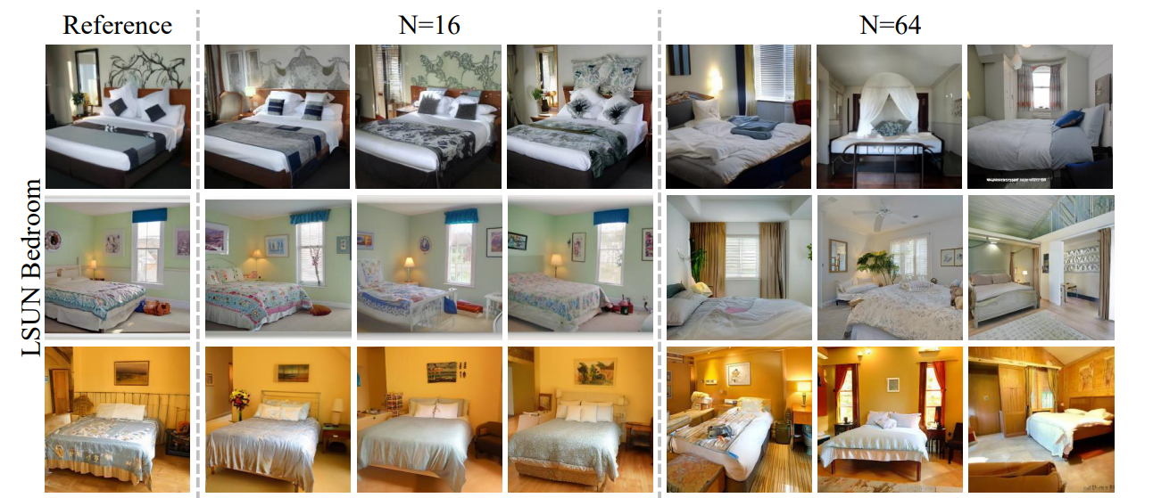
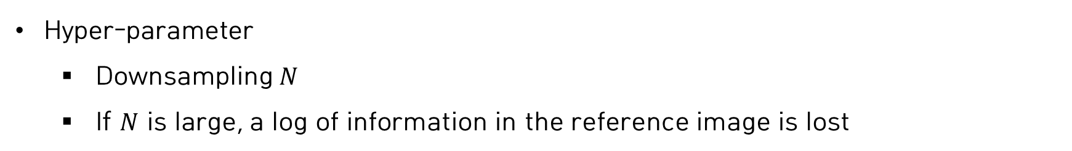
Method
Hyper-parameter
Downsampling $N$
If $N$ is large, a log of information in the reference image is lost

Slide 25
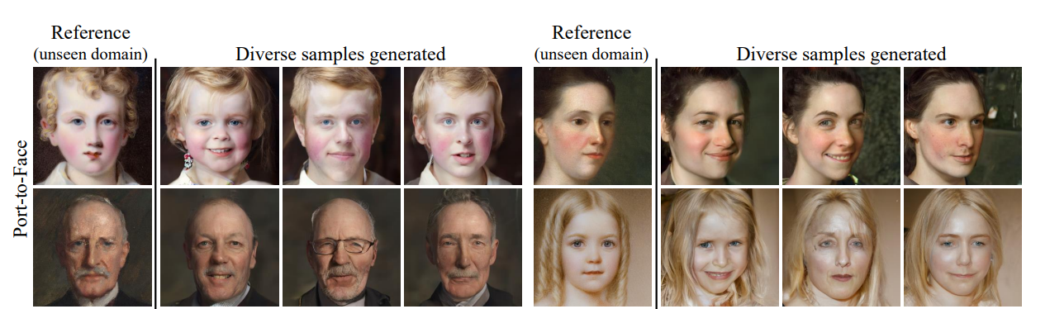
Experiments
Unseen domain

Slide 26
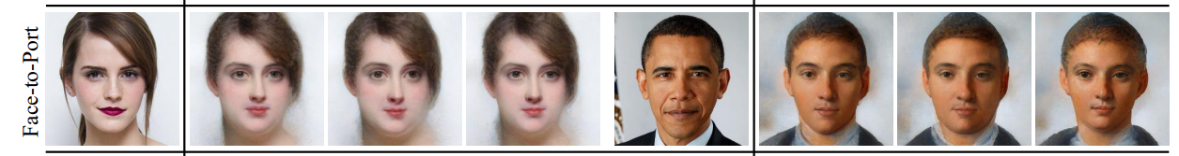

Experiments
Unseen domain
Realistic $→$portrait

Slide 27
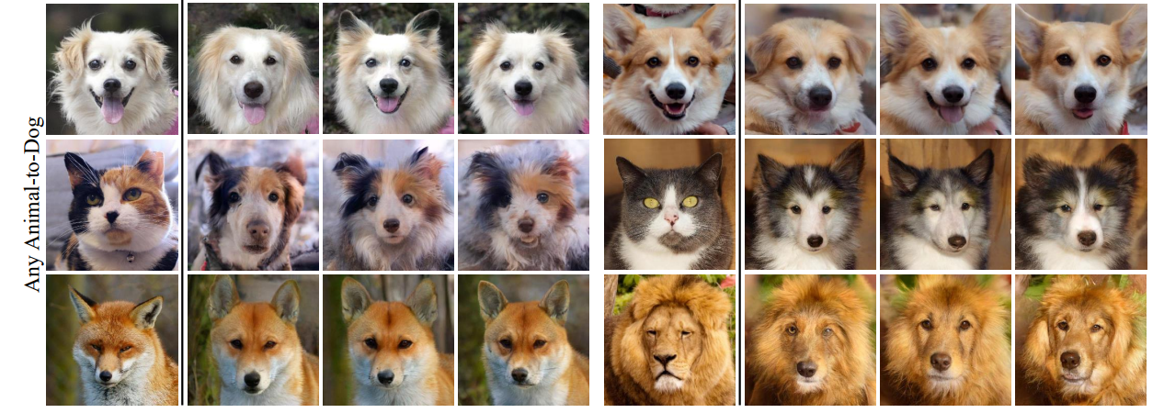

Experiments
Unseen domain
Any animal $→$ Dog

Slide 28
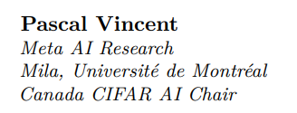
RCDM: High Fidelity Visualization of What Your Self-Supervised Representation Knows About
arXiv, 2021, 34 citation

Slide 29
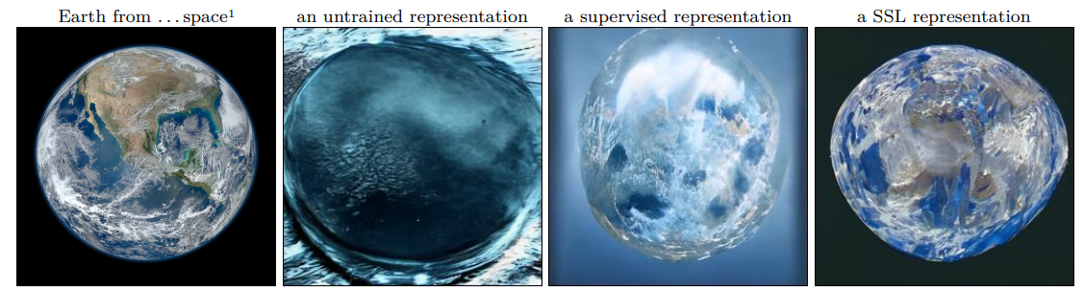
Intro
Objective
Visualization of self-supervised representations

Slide 30
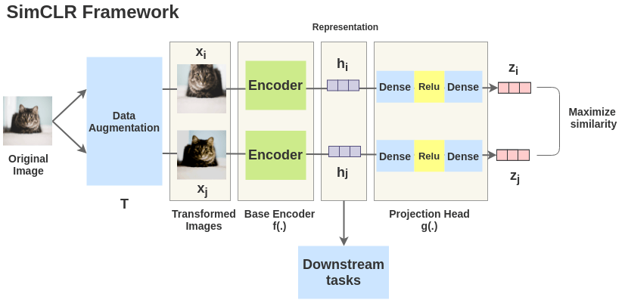
Background
Self-supervised learning
First: train backbone (resnet 50/ViT) + projector (small NLP)
Second: discard projector and use backbone network
Invariance

Slide 31
Method
What information does the learned representation contain?
Why do we use representations at backbone level?
Is self-supervised learning really invariant to data augmentation?

Slide 32
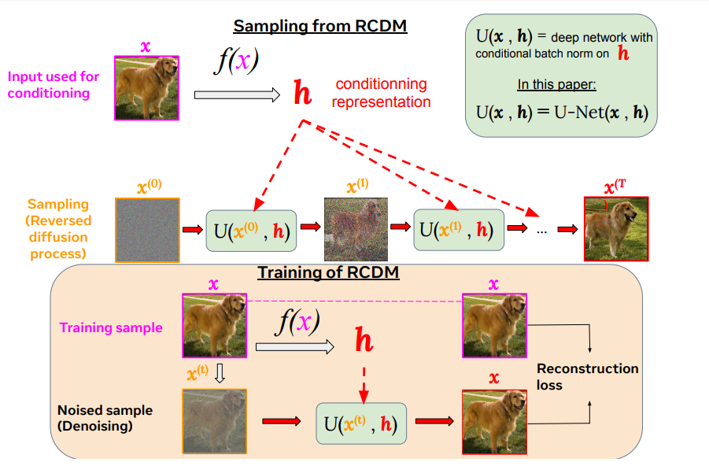
Method
RCDM
Iteratively sampling via diffusion models given representation
Assume that what is commonly found is encoded

Slide 33
Method
Visualization
Diffusion model
High-quality samples
Samples are faithful: diffusion model is suitable for receiving large vector representations as a condition; create by reflecting the condition well
GAN is unstable and has mode collapse

Slide 34
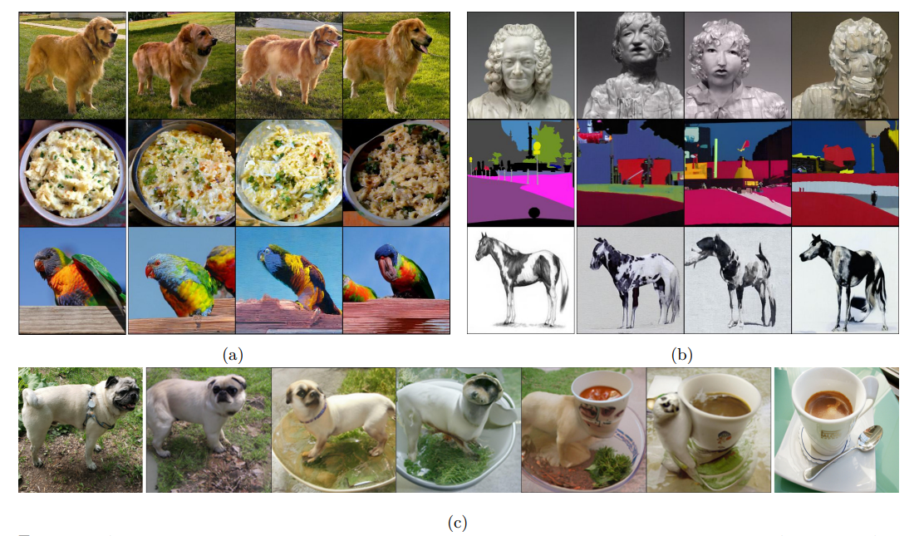
Method
Setting: ImageNet | ResNet 50 | Dino
(a): In-distribution, (b): Out of distribution, (c): Linear Interpolation

Slide 35
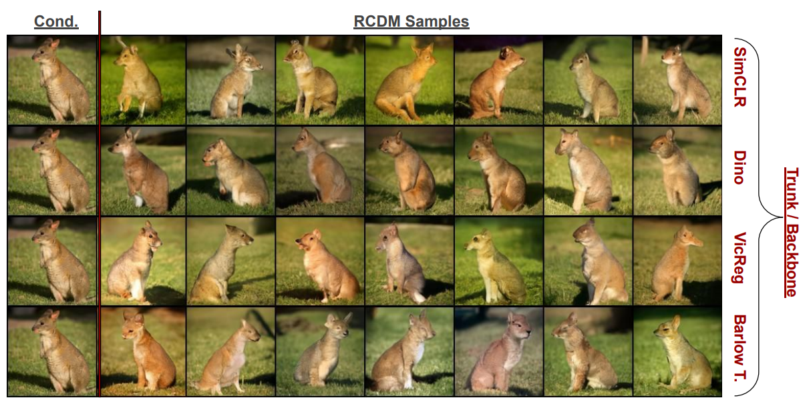
Method
What information does the learned representation contain?

Slide 36
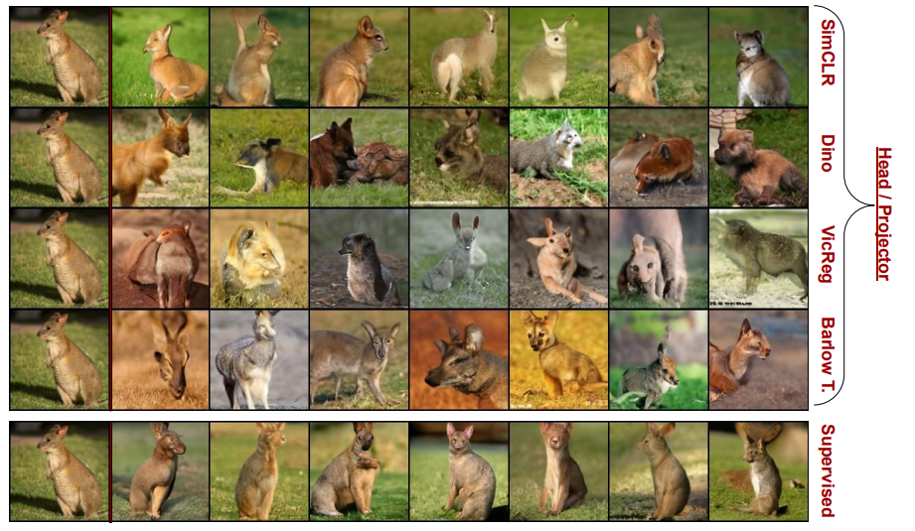
Method
What information does the learned representation contain?

Slide 37
Method
What information does the learned representation contain?
Backbone representation: contains detailed information on the input image
Projector representation: only contains global information

Slide 38
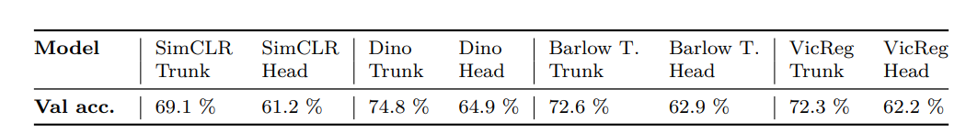
Method
What information does the learned representation contain?
Backbone representation: contains detailed information on the input image
Projector representation: only contains global information
Why do we use representations at backbone level?

Slide 39
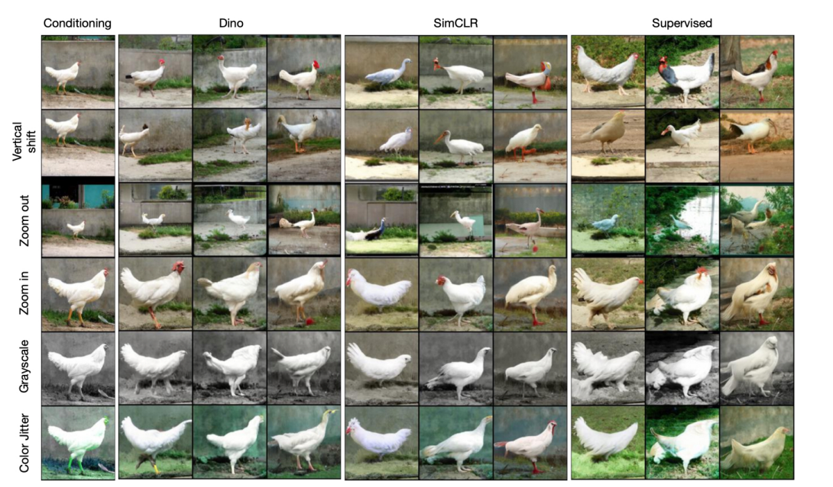
Method
Is self-supervised learning really invariant to data augmentation?

Slide 40
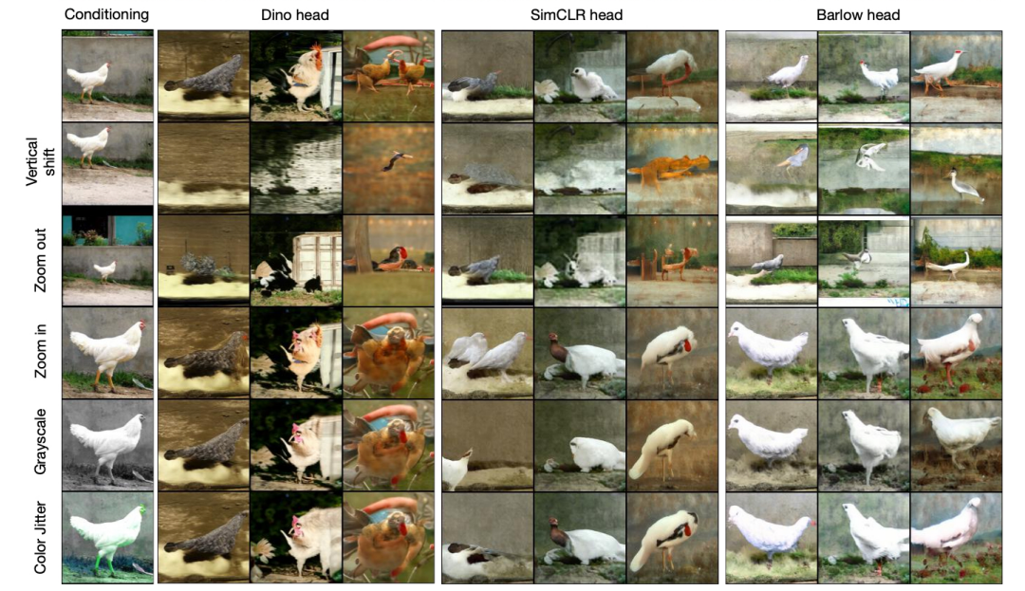
Method
Is self-supervised learning really invariant to data augmentation?

Slide 41
Method
Is self-supervised learning really invariant to data augmentation?
Backbone representation: not invariant
Projector representation: invariant

Slide 42
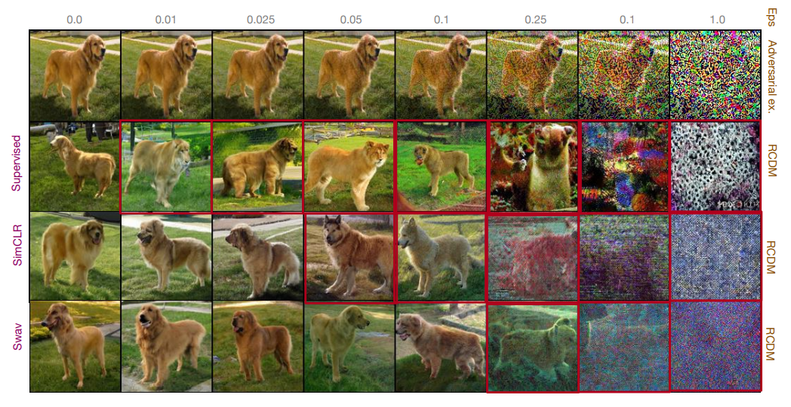
Method
Robustness against adversarial attack
Use Fast Gradient Sign attacks (FGSM)

Slide 43
Conclusion
 | Information about input image | Invariance to Data augmentation
Backbone | Global + Detailed information | Not invariance
Projector | Global information | invariance

